Slide 1

Core OSINT: Keeping Track of and Reporting All the Things
Micah Hoffman
https://webbreacher.com
©2018 Spotlight Infosec LLC

Slide 2



Who am I?
OSINTer / Pentester
Mentor / Advisor
Author and Instructor SANS SEC487 OSINT Course
Open Source Fan

Slide 3
A question…

Slide 4
A question…
Raise your hand if you love to document?

Slide 5
Most Fun for Young Micah

Slide 6
Most Fun for Experienced Micah

Slide 7
Ever write a report and realize you didn't have certain data?

Slide 8
Document deeply during the
assessment

Slide 9
Great Documentation can lead to
Great Reporting

Slide 10





If you use these to document

Slide 11
Documentation Goals

Slide 12
Documentation Goals
Types of data we will collect
How many people are working?
Why are you documenting?
What are your end goals?

Slide 13
Types of OSINT Data
Images
Videos
Downloads
Web pages
Text
Analysis
URLs
Dates/times
Command line tool output

Slide 14
Considerations
Sensitive data
Duplicate data (same phone, multiple people)
Time frames for collection
Weeks? Months? Hours?

Slide 15
Number of OSINTers
How many people will be contributing?
Just you?
Team? Geographically-dispersed?
Enterprise?

Slide 16
Considerations
Cloud storage vs local/intranet
Multi-user apps vs single

Slide 17
Why are you documenting?
Only for our use?
Used for a deliverable?
We collect data provide our analyses and recommendations

Slide 18
Considerations
Document to highest standards
You can always summarize afterwards
Hard to add what you skipped (might not be there)

Slide 19
What is the end goal?
Document to continue
Document to hand-off
Document to report
Document to archive
Document to analyze/pivot

Slide 20
Considerations
You don't know where the assessment will "take you"
More details mean easier handoff

Slide 21

OSINT Process
What are we reporting?
What are we doing?
What are we missing?
What are we finding?

Slide 22
An example…

Slide 23
An example…
You are working for a school
Cyber-bullying via Playstation (PS4) gaming
"drdpiratroberts" == bully
Find who this is

Slide 24
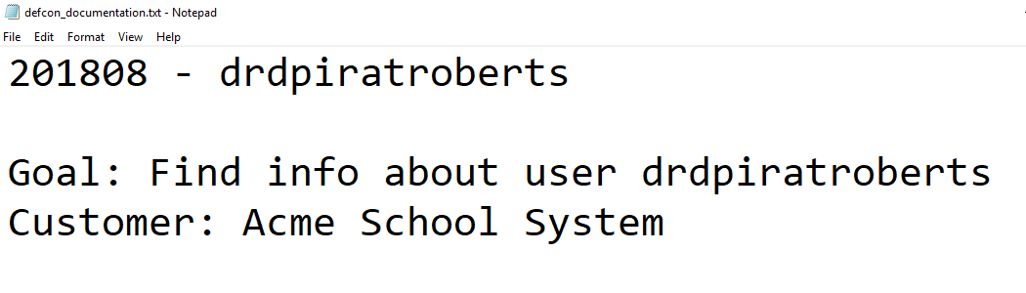

Slide 25
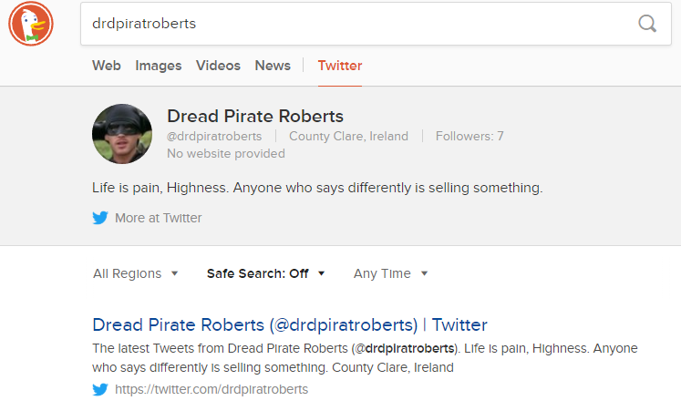

Slide 26
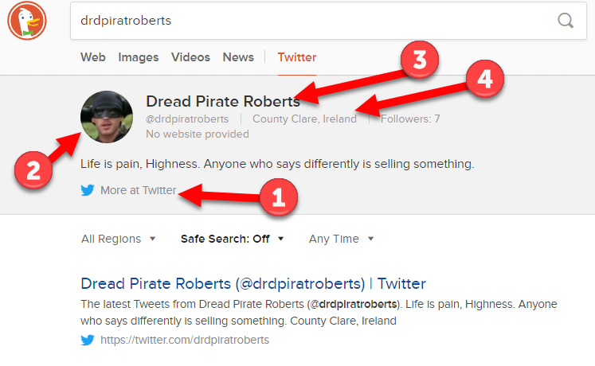

Slide 27
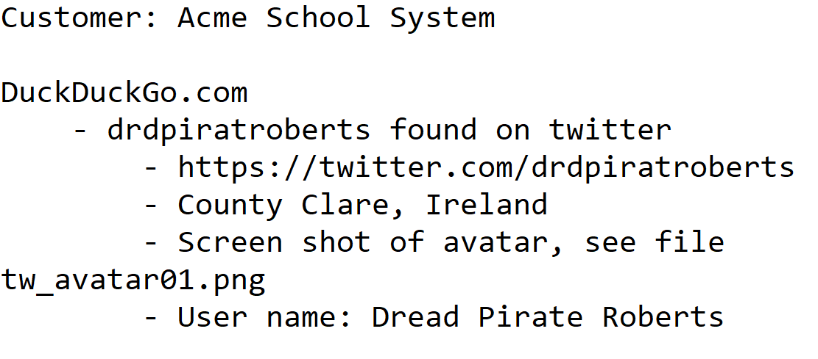

Slide 28
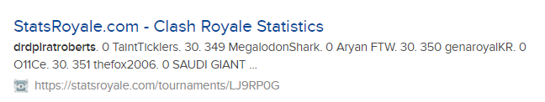
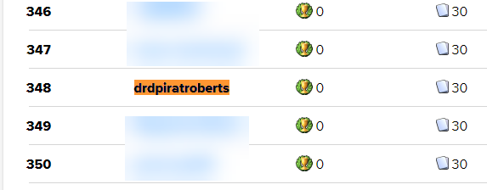

Slide 29
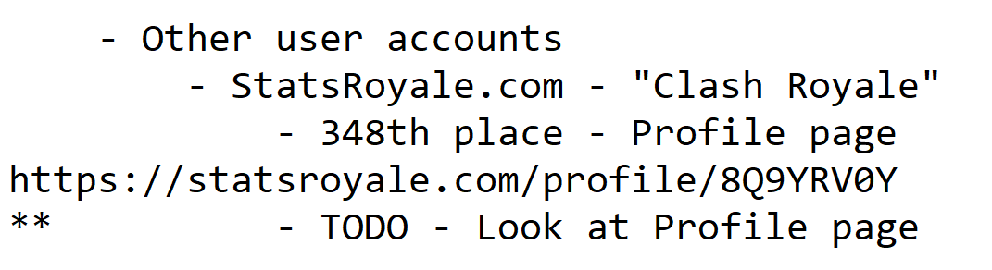

Slide 30
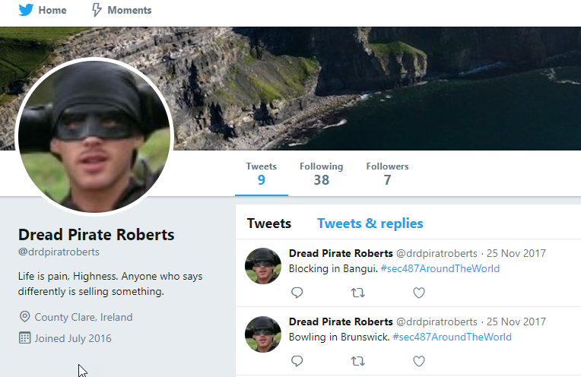

Slide 31
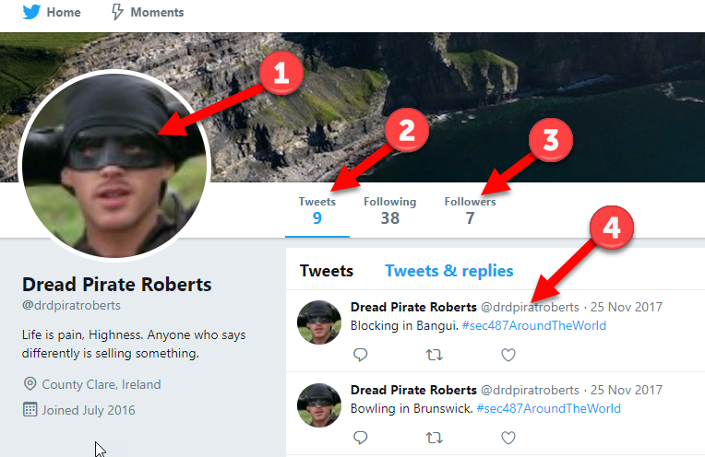

Slide 32
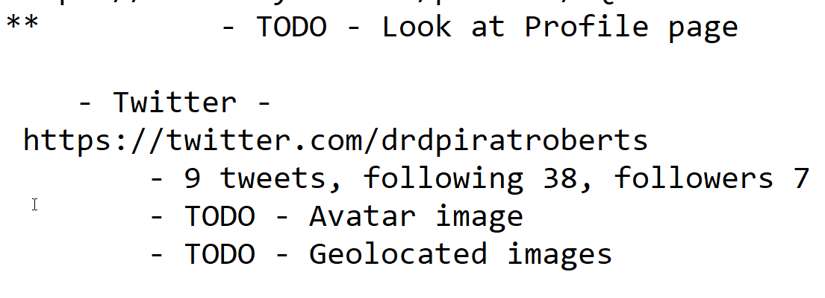

Slide 33
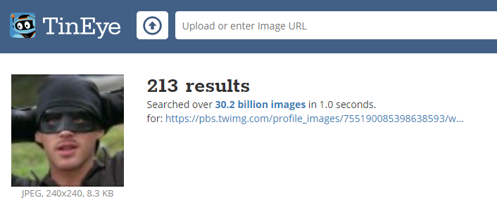

Slide 34
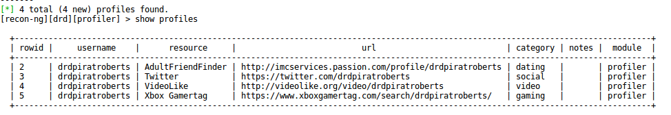

Slide 37
So where are we?
Many "to do" items (pivots)
Images
Text
URLs
Tool output (text/CSV)

Slide 38
And this is only
10 minutes into
the assessment!

Slide 39
What don't we have?
Pictures of each page visited
Dates and times when visited
Images and text combined
Time-line/how did we find that?

Slide 40
Disclaimers:
Targets for this talk are solo OSINTers and small/medium-sized companies
You need to find out what works for you/your team

Slide 41
Documenting Tools
Word Processors/Text Editors
Report-writing
General documentation
Documenting Apps
Meant for recording your work for you
Trail of your work
Visualizers
Good for analyzing relationships between objects
Analyzing large data sets
Note-taking Apps
Dedicated to recording (manually) notes on your work

Slide 42
Let's Focus
Most flexible
Most complete features
Easiest to use
Decreases our work

Slide 43
MindMaps
Visual note taking
Embed images and documents
Some are multi-user
Easy to see findings and TODOs

Slide 44

OSINT_Maps.xmind
https://github.com/WebBreacher/osinttools/
Free (Xmind.net)
Community-created
Templated content

Slide 45
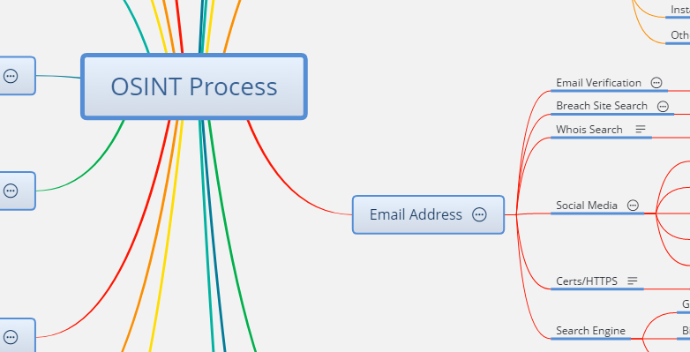
OSINT Process Tab

Slide 46
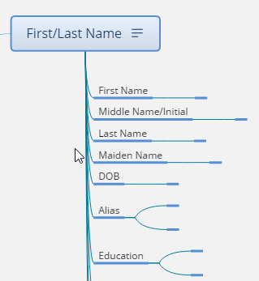
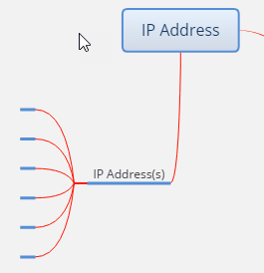
Data Collection Tab

Slide 47
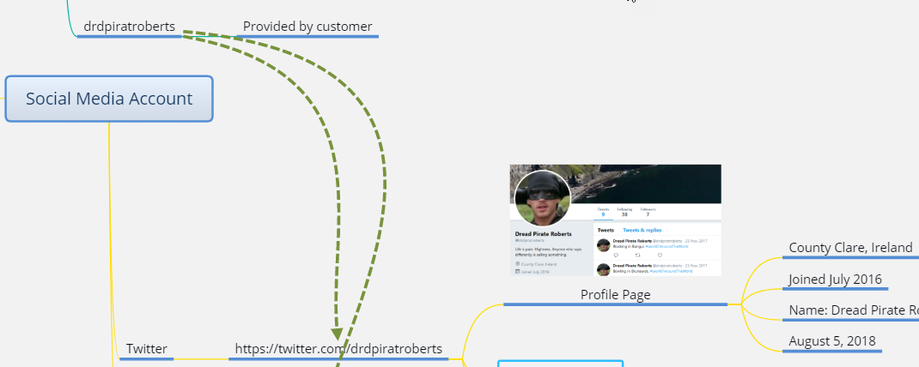

Slide 48
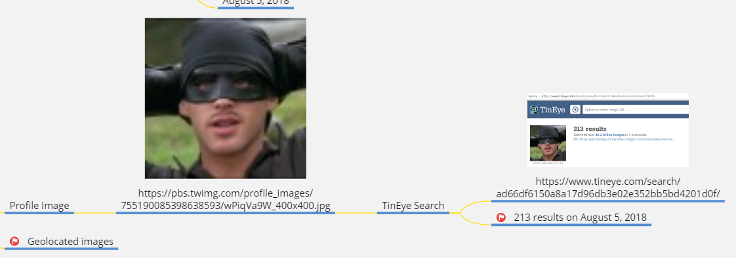

Slide 49
MindMap Drawbacks
Exporting data can be challenging
Multi-user support is so-so
Manual data entry process

Slide 50

Hunch.ly
Passively extracts data
Automated recording of browser
Time-lining
Hashing of images
Downloaded files, included
Google Chrome Extension
Can$130/year
https://hunch.ly

Slide 51
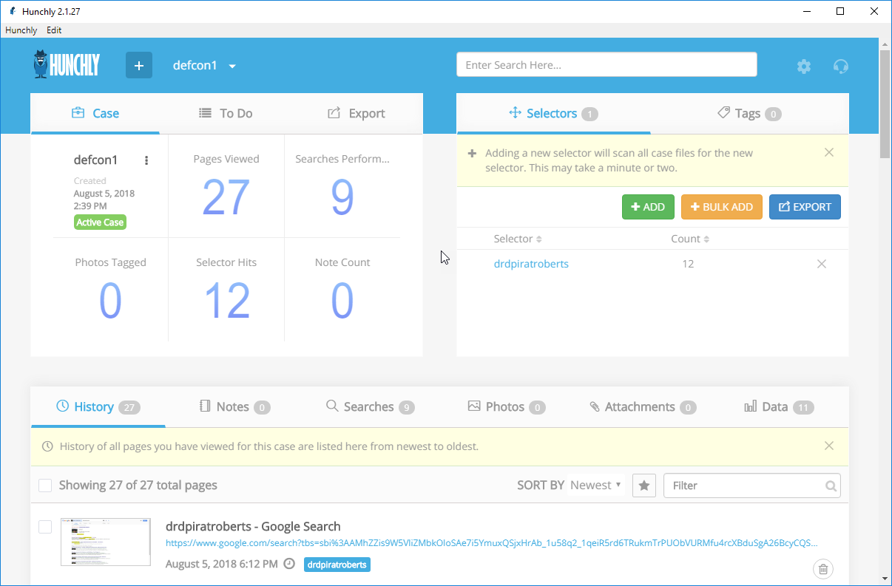
Dashboard
with case summary data

Slide 52
Enter selectors so Hunchly can find them in pages/files

Slide 53
Shows all the pages you visited in order
Date/time/URL stamps
Hashes images (integrity)
Extracts meta-data from images

Slide 54
Side-loading Cmd-line Output
Run command-line tool
Save output in text file
Open that file in Google Chrome
Hunchly logs and scans file

Slide 55
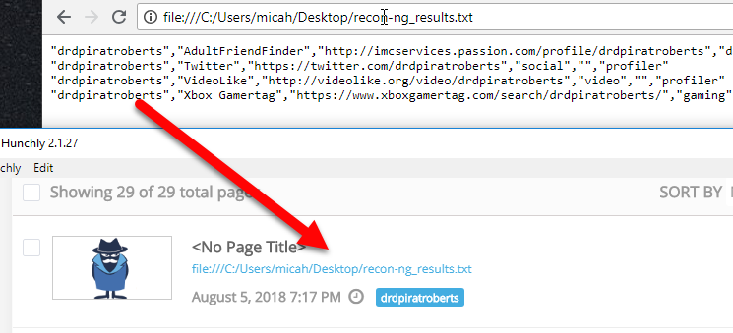

Slide 56
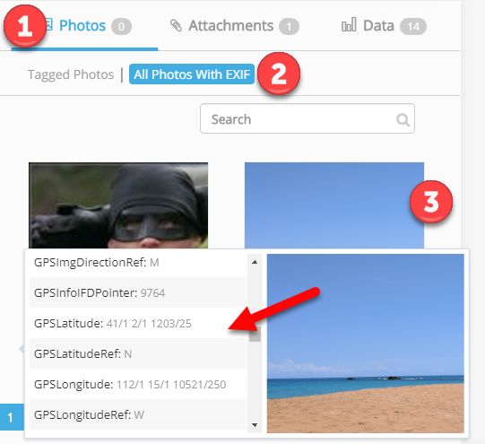

Slide 57
Hunchly Drawbacks
Reporting is good but not great
Single-user
Google Chrome-only

Slide 58

Putting
it all together

Slide 59
If you know:
Why you are documenting
Where you are documenting
Who you are documenting with
Who you are documenting for

Slide 60
Then:
Find documenting tools that make things easier
And work how you/your team do
Many apps have trials or are free

Slide 61
We can do better than…

Slide 62
We have the tools

Slide 63

https://www.sans.org/sec487
Micah Hoffman
@WebBreacher
https://webbreacher.com
https://the.osint.ninja/presos

